Slide 1
Introduction to audio coding
Xavier Serra

Slide 2
Index
Sampling and quantization
Types of audio coders
Audio coder attributes
Example audio codecs

Slide 3
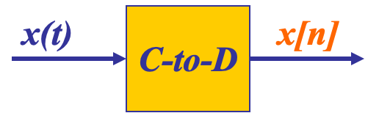
Sampling
SAMPLING PROCESS
Convert x(t) to numbers x[n], where n is an integer index
SAMPLING RATE (fs)
fs =1/Ts , samples per second, units of fs are Hertz
Uniform sampling at t = nTs = n/fs; x[n] = x(nTs)=x(n/fs)
= x(nTs)

Slide 4
Storing digital sound
x[n] is a SAMPLED SIGNAL
A list of numbers stored in memory
EXAMPLE: audio CD
Sampling rate: 44,100 samples per second (Hz)
Bit depth: 16-bit samples
Number of channels: 2 channels
Bitrate: 2 X 16 X 44100 = 1411.2 Kbit/s

Slide 5
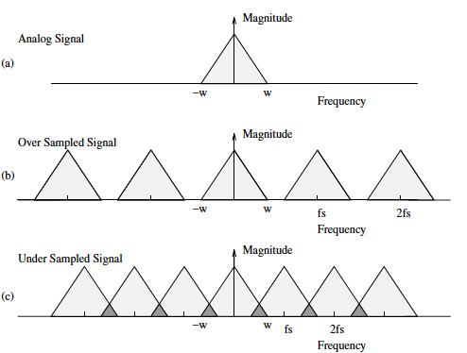
Sampling theorem (by Shannon)
A continuous-time signal x(t) with frequency no higher than fmax (w) can be reconstructed exactly from its samples x[n] = x(nTs) if the samples are taken at a rate fs = 1/Ts that is greater than 2fmax

Slide 6
Types of audio coders
Lossless vs lossy
Lossless coders achieve compression rations from 2:1 to 4:1.
Lossy coders exploit perceptual irrelevant information, achieving 10:1 to 25:1 compression ratios.
Linear predictive coders
Exploit short- and long-term correlations of signal using source-filter representations.
Mainly used for speech signals.
Transform and subband coders
Mainly use time-frequency transforms (DFT, DCT, …).
Mostly used in MPEG coders and include perceptual models.
Sinusoidal
Based on sinusoidal model.
Neural coders
Based on deep learning.

Slide 7
Audio coder attributes
Audio quality: various perceptual assessment methods.
Bit rate: measured as kb/s.
Computational complexity: related to real-time implementation.
Codec delay: up to 100-200 ms for network applications.
Error robustness: need to deal with noisy time-varying channels.

Slide 8
Example audio coders
Pulse code modulation (.wav)
Lossless coding (.flac)
Perceptual coding (.mp3)
Advanced audio coding (.aac)
Neural audio coding (.ecddc)

Slide 9
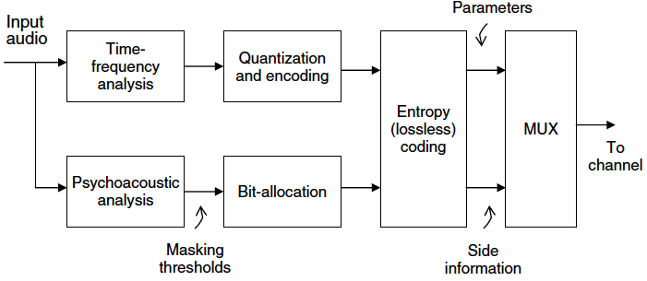
Generic perceptual audio encoder

Slide 10
Uncompressed audio as stored on an audio-CD has a bit rate of 1,411.2 kbit/s, (16 bit/sample × 44,100 samples/second × 2 channels / 1,000 bits/kilobit).
Bit rates 128, 160, and 192 kbit/s, achieved with codecs like MP3, represent compression ratios of approximately 11:1, 9:1 and 7:1 respectively.

Slide 11
References
“Chapter 1: Introduction” in Andreas Spanias, Ted Painter, and Venkatraman Atti (2007). Audio Signal Processing and Coding. John Wiley & Sons, Inc.
https://github.com/xserra/audio-coding-materials/
examples/sound-display.ipynb
examples/downsample-chirp.ipynb
examples/resample.ipynb
examples/mp3-coding.ipynb

